Slide 1
Economic Study for the New England Governors: Renewable Development Scenario Analyses
New England Electricity Restructuring Roundtable September 18, 2009
Stephen J. Rourke
Vice President, System Planning

Slide 2
Governors Request ISO Technical Support for Regional “Blueprint”
States seek to identify “significant sources of renewable energy available to New England, the most effective means to integrate them into our power grid, and the estimated costs.”
New England States Committee on Electricity (NESCOE), March 2009
Request economic study for 2009, in accordance with Attachment K of the ISO Open Access Transmission Tariff (OATT)
Initial economic and transmission analysis complete

Slide 3
Economic Study: Approach
ISO conducted “scenario analysis” for renewable development, focused primarily on wind
Up to 12,000 MW of wind in New England
7,500 MW onshore and 4,500 MW offshore
Offshore distributed evenly between Maine, Massachusetts, Rhode Island
Incremental cases: 2,000 MW / 4,000 MW / 8,000 MW
Nameplate capacity ratings
Other resources
Demand resources, plug-in electric vehicles (PEVs), energy storage, and expanded imports
Range of resource penetrations (low / medium / high)

Slide 4
Economic Study: Approach, cont.
Timing and sensitivities
Evaluated long-term horizon: approximately 20 years into the future (around 2030)
Evaluated generator retirement and repowering scenarios for units in service for 50 / 60 / 70 years by the year 2030
Evaluated sensitivity of each scenario to higher fuel prices, transmission constraints
States developed study assumptions with technical support from ISO

Slide 5
Study Results
Environmental metrics
Wind scenarios produce the lowest SO₂, NOx, and CO₂ emissions; retirement and repowering scenarios also produce significant SO₂, NOx, and CO₂ reductions
SO₂ emissions are higher in sensitivity cases with higher fuel prices as oil units run more often when gas prices are high
Energy contribution from wind and hydro
Developing 5,500 MW of wind could supply 12% of New England’s energy in 2030
Developing 12,000 MW of wind and expanding ties with Eastern Canada (assumed to be wind/hydro) could supply 35% of New England’s energy in 2030

Slide 6
Study Results, cont.
Wholesale Electric Energy Prices
Average annual prices are lower in scenarios that add low-cost energy to the system (such as higher wind penetration) or remove energy from the system (such as higher demand-resource penetration)
Retiring large amounts of fossil fuel generators and replacing them with advanced natural gas units also produces lower prices
Some resources would retire if energy market revenues were reduced or would need to consider other sources of revenue
Wholesale electric energy prices do not include capital costs of the resources and associated transmission

Slide 7
Increased Wind Capacity and Imports Lower Energy Clearing Prices

Slide 8
Increased Wind Capacity and Imports Significantly Lower CO₂ Emissions

Slide 9
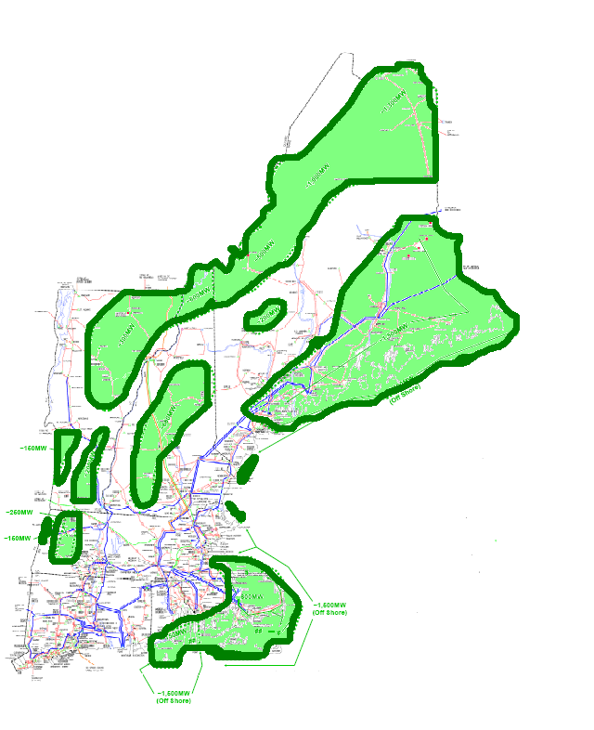
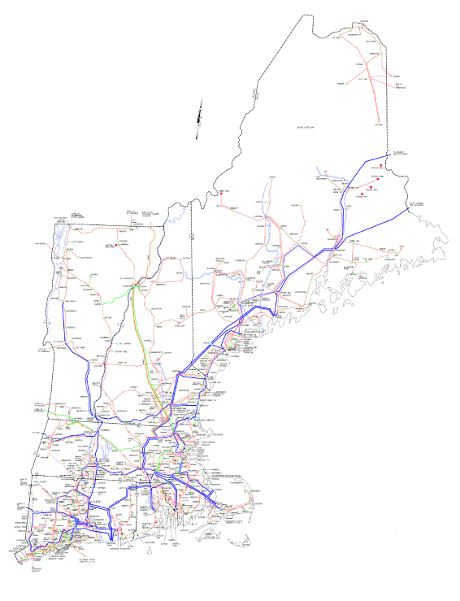
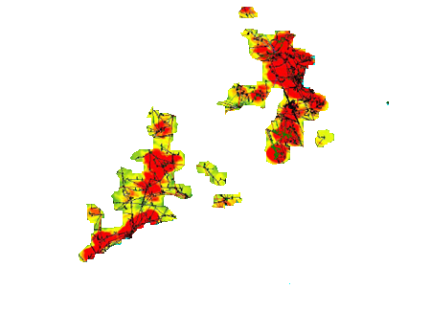
Connecting Wind Energy to Load Centers
Population and electric demand are concentrated along the coast in central and southern New England
12,000 MW of onshore and offshore wind potential
Preliminary screening eliminated wind sites near urban areas and sensitive geographic locations (e.g., Appalachian Trail)
Transmission required to connect wind resources to load centers
Electricity Demand
Wind zones
Notes:
Population:
-- Massachusetts, Connecticut and Rhode Island are among the leading states nationally in coastal population density (persons per square mile) (National Overview, p. 7.)
-- Coastal population density is higher than overall state population density for all New England states except Vermont (Appendix C: Northeast)
Source: Population Trends Along the Coastal United States: 1980-2008, U.S. Department of Commerce National Oceanic and Atmospheric Administration, National Ocean Service, September 2004.
Electricity demand :
-- Red and yellow coloring shows peak load distribution in New England
Source: 2008 Regional System Plan, Northern New England and Southern New England summer peak load distribution (Figures 11-1 and 11-4.)
-- 80% of region’s electricity demand is in Southern New England (Massachusetts, Connecticut, Rhode Island)
Source: 2008 Regional System Plan, Forecasts of Peak Use of Electric Energy for Load Zones and the New England States, 2008 (Table 3-5.)

Slide 10
Transmission Scenarios
ISO developed 16 conceptual transmission scenarios
13 scenarios to connect wind in New England, and
3 scenarios to expand ties to neighboring regions
Transmission scenarios developed as robust, workable solutions with cost estimates based on actual project experience
More detailed transmission studies would be required if the region pursues specific projects
New voltage classes may be needed for higher wind penetration scenarios (345 kV is the backbone of the existing system)

Slide 11
Summary of Scenarios for Renewable Resources Offshore and inland wind, imports can achieve 15% renewables
Description Partial list of scenarios | New Capacity (Megawatts) | Percent of New England Energy (%) | Preliminary Transmission Cost Estimates (Billions)
From New England:
4,000 MW of offshore wind plus 1,500 MW of inland wind* | 5,500 MW | 12% | $4.7 B to $7.6 B
12,000 MW of wind | 12,000 MW | 23% | $19 B to $25 B
From New England and Eastern Canada:
5,500 MW of wind (from above) plus 3,000 MW of additional imports from Québec and New Brunswick** | 8,500 MW | 15% | ~$7 B to ~$12 B
12,000 MW of New England wind plus 3,000 MW of additional imports from Québec and New Brunswick** | 15,000 MW | 26% | ~$17 B to ~$36 B
* Offshore wind was assumed to have a capacity factor of 40.7 percent. Onshore wind outside of Maine was assumed to have a capacity factor of 35.4 percent, while onshore wind in Maine and New Brunswick was assumed to have a 29.3 percent capacity factor
** Estimate does not include facilities in Québec and New Brunswick; only includes cost of potential transmission in New England

Slide 12
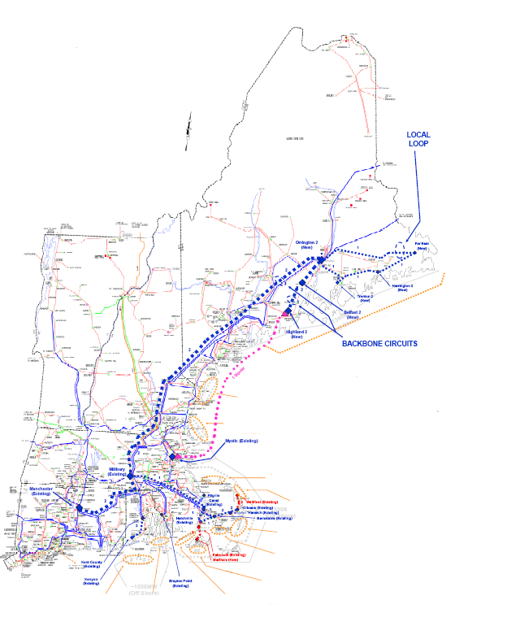
Transmission for 5,500 MW of Wind
Potential transmission to connect 4,000 MW of offshore and 1,500 MW of near-shore onshore wind
New transmission paths
New 345 kV line from Maine to Connecticut
New HVDC underwater cable from Maine to Boston
Local loops to collect wind in Maine
Preliminary cost estimate:
$6 billion

Slide 13
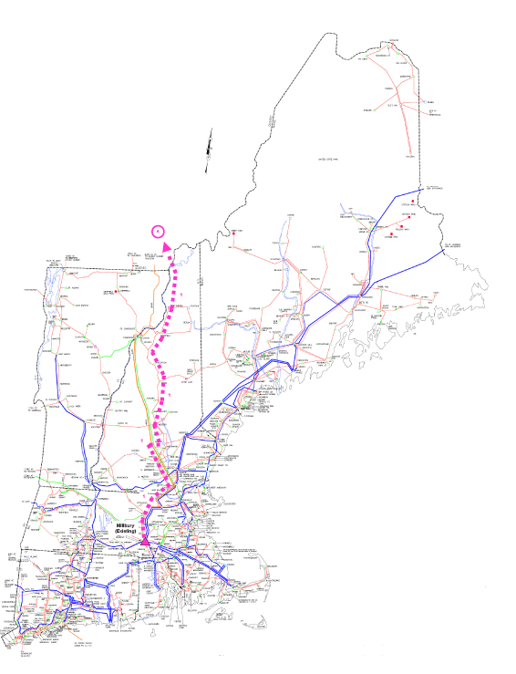
Transmission for 3,000 MW of Imports
Potential new transmission ties to Quebec and New Brunswick
Import 1,500 MW via new +/-450 kV HVDC line
Preliminary cost estimate: $1.6 billion
Import 1,500 MW via new +/-450 kV HVDC line
Preliminary cost estimate: $2 billion
Cost estimates represent only the cost of potential transmission facilities in New England

Slide 14
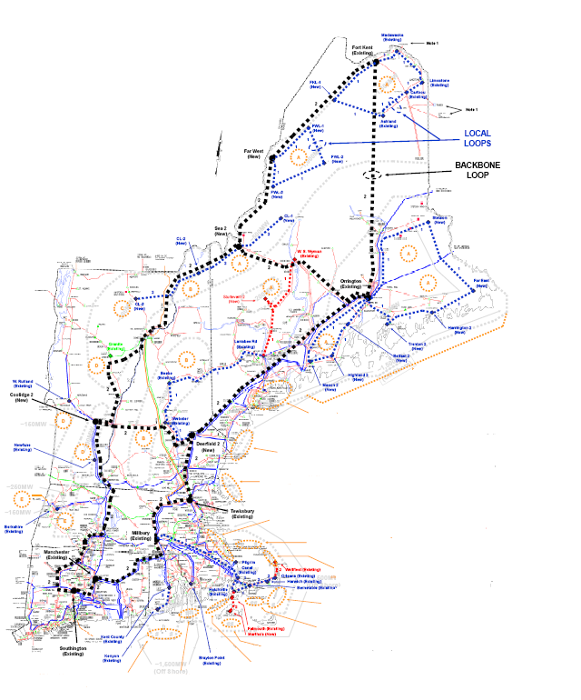
Transmission for 12,000 MW of Wind
New higher voltage backbone loop around New England
Local loops to collect wind in Maine
Preliminary cost estimates
500 kV: $19 billion
765 kV: $25 billion

Slide 15
Economic Study: Highlights
Region has significant renewable options nearby
New England has significant potential to develop onshore and offshore renewable resources and to expand trade with nearby Eastern Canada
Transmission investment will be needed
Transmission will be needed to integrate renewable resources into the electric grid and deliver energy from remote areas to load centers
Region has success building transmission
New England’s success developing major reliability projects is a solid platform for studies to evaluate additional transmission scenarios
ISO, New England transmission owners, and state officials play critical roles in transmission development

Slide 16
Next Steps
Economic Study submitted to New England Governors and presented to stakeholders
Available at: http://www.iso-ne.com/committees/comm_wkgrps/prtcpnts_comm/pac/reports/index.html
New England Governors and Eastern Canadian Premiers consider study results
Seek additional information on import scenarios based on further conventional hydro and tidal power development in the Atlantic Provinces
Planning Advisory Committee (PAC) members have also made suggestions for additional sensitivities, such as the impact of higher CO₂ costs

